Slide 1
MODULE 2
Principles of Software Design

Slide 2
The Process of Design
Definition:
Design is a problem-solving process whose objective is to find and describe a way:
To implement the system’s functional requirements...
While respecting the constraints imposed by the quality, platform and process requirements...
including the budget and deadlines
And while adhering to general principles of good quality

Slide 3
Design as a series of decisions
A designer is faced with a series of design issues
These are sub-problems of the overall design problem.
Each issue normally has several alternative solutions:
design options.
The designer makes a design decision to resolve each issue.
This process involves choosing the best option from among the alternatives.

Slide 4
Making decisions
To make each design decision, the software engineer uses:
Knowledge of
the requirements
the design as created so far
the technology available
software design principles and ‘best practices’
what has worked well in the past

Slide 5
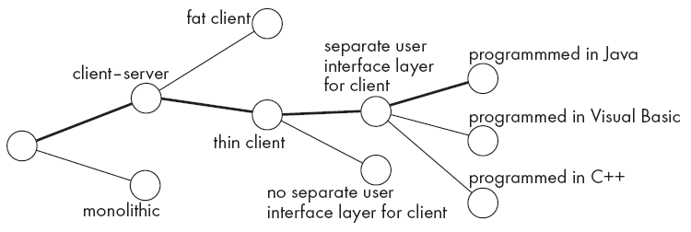
Design space
The space of possible designs that could be achieved by choosing different sets of alternatives is often called the design space
For example:

Slide 6
Parts of a system: subsystems, components and modules
Component
Any piece of software or hardware that has a clear role.
A component can be isolated, allowing you to replace it with a different component that has equivalent functionality.
Many components are designed to be reusable.
Conversely, others perform special-purpose functions.

Slide 7
Module
A component that is defined at the programming language level
For example, methods, classes and packages are modules in Java.

Slide 8
System
A logical entity, having a set of definable responsibilities or objectives, and consisting of hardware, software or both.
A system can have a specification which is then implemented by a collection of components.
A system continues to exist, even if its components are changed or replaced.
The goal of requirements analysis is to determine the responsibilities of a system.
Subsystem:
A system that is part of a larger system, and which has a definite interface

Slide 9
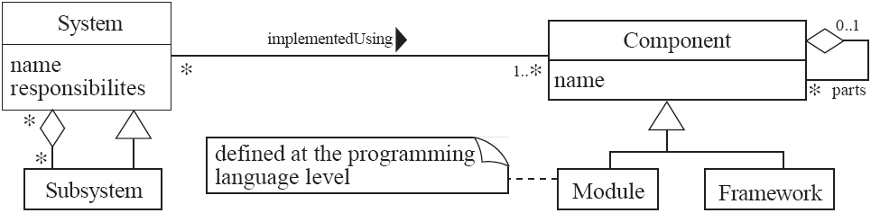
UML diagram of system parts

Slide 10
Top-down and bottom-up design
Top-down design
First design the very high level structure of the system.
Then gradually work down to detailed decisions about low-level constructs.
Finally arrive at detailed decisions such as:
the format of particular data items;
the individual algorithms that will be used.

Slide 11
Top-down and bottom-up design
Bottom-up design
Make decisions about reusable low-level utilities.
Then decide how these will be put together to create high-level constructs.
A mix of top-down and bottom-up approaches are normally used:
Top-down design is almost always needed to give the system a good structure.
Bottom-up design is normally useful so that reusable components can be created.

Slide 12
Different aspects of design
Architecture design:
The division into subsystems and components,
How these will be connected.
How they will interact.
Their interfaces.
Class design:
The various features of classes.
User interface design
Algorithm design:
The design of computational mechanisms.
Protocol design:
The design of communications protocol.

Slide 13
Principles Leading to Good Design
Overall goals of good design:
Increasing profit by reducing cost and increasing revenue
Ensuring that we actually conform with the requirements
Accelerating development
Increasing qualities such as
Usability
Efficiency
Reliability
Maintainability
Reusability

Slide 14
Design Principle 1: Divide and conquer
Trying to deal with something big all at once is normally much harder than dealing with a series of smaller things
Separate people can work on each part.
An individual software engineer can specialize.
Each individual component is smaller, and therefore easier to understand.
Parts can be replaced or changed without having to replace or extensively change other parts.

Slide 15
Ways of dividing a software system
A distributed system is divided up into clients and servers
A system is divided up into subsystems
A subsystem can be divided up into one or more packages
A package is divided up into classes
A class is divided up into methods

Slide 16
Design Principle 2: Increase cohesion where possible
A subsystem or module has high cohesion if it keeps together things that are related to each other, and keeps out other things
Cohesion is also called Intra-Module Binding.
This makes the system as a whole easier to understand and change
Type of cohesion:
Functional,
Layer
Communicational
Sequential
Procedural
Temporal
Utility

Slide 17
Functional cohesion
This is achieved when all the code that computes a particular result is kept together - and everything else is kept out
i.e. when a module only performs a single computation, and returns a result, without having side-effects.
Benefits to the system:
Easier to understand
More reusable
Easier to replace
Modules that update a database, create a new file or interact with the user are not functionally cohesive

Slide 18
Layer cohesion
All the facilities for providing or accessing a set of related services are kept together, and everything else is kept out
The layers should form a hierarchy
Higher layers can access services of lower layers,
Lower layers do not access higher layers
The set of procedures through which a layer provides its services is the application programming interface (API)
You can replace a layer without having any impact on the other layers
You just replicate the API

Slide 19
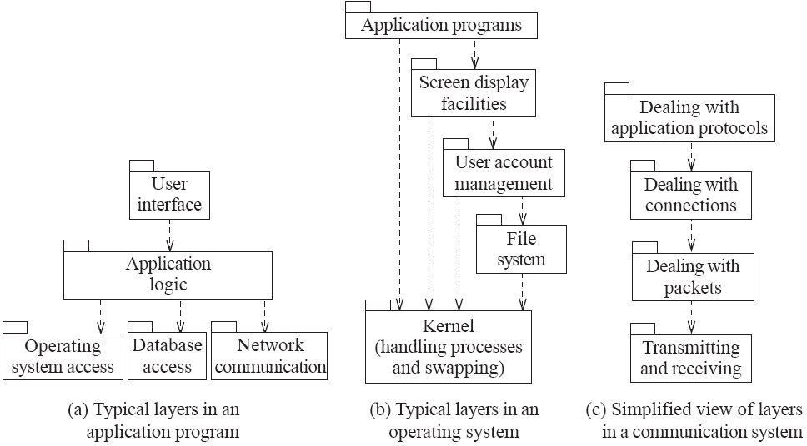
Example of the use of layers

Slide 20
Communicational cohesion
All the modules that access or manipulate certain data are kept together (e.g. in the same class) - and everything else is kept out
A class would have good communicational cohesion
if all the system’s facilities for storing and manipulating its data are contained in this class.
if the class does not do anything other than manage its data.
Main advantage: When you need to make changes to the data, you find all the code in one place

Slide 21
Sequential cohesion
Procedures, in which one procedure provides input to the next, are kept together – and everything else is kept out
You should achieve sequential cohesion, only once you have already achieved the preceding types of cohesion.

Slide 22
Procedural cohesion
Procedures that are used one after another are kept together
Even if one does not necessarily provide input to the next.
Weaker than sequential cohesion.
Example of Procedural Cohesion
module write read and edit something
use out record
write out record
read in record
pad numeric fields with zeros
return in record

Slide 23
Temporal Cohesion
Elements are involved in activities that are related in time
Operations that are performed during the same phase of the execution of the program are kept together, and everything else is kept out
For example, placing together the code used during system start-up or initialization.
Weaker than procedural cohesion

Slide 24
Utility cohesion
When related utilities which cannot be logically placed in other cohesive units are kept together
A utility is a procedure or class that has wide applicability to many different subsystems and is designed to be reusable.
For example, the java.lang.Math class.

Slide 25
Design Principle 3: Reduce coupling where possible
Coupling occurs when there are interdependencies between one module and another
When interdependencies exist, changes in one place will require changes somewhere else.
A network of interdependencies makes it hard to see at a glance how some component works.
Type of coupling:
Content,
Common,
Control
Stamp
Data
Routine Call
Type use
Inclusion/Import
External

Slide 26
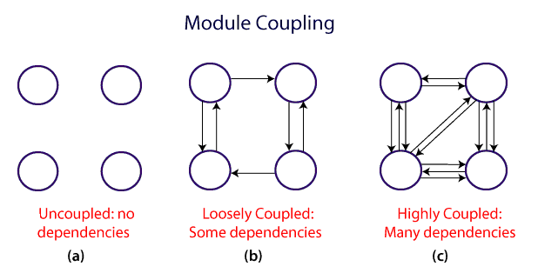
Tightly coupled system and a loosely coupled system

Slide 27
Content coupling:
Occurs when one component surreptitiously modifies data that is internal to another component .
To reduce content coupling you should therefore encapsulate all instance variables
declare them private
and provide get and set methods
This is the worst form of coupling and should be avoided.

Slide 28
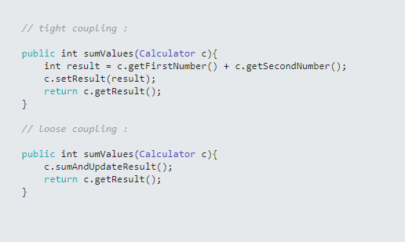
Example….

Slide 29
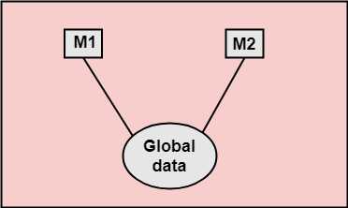
Common coupling
Occurs whenever you use a global variable
All the components using the global variable become coupled to each other
A weaker form of common coupling is when a variable can be accessed by a subset of the system’s classes.
e.g. a Java package
Encapsulation reduces the harm of global variables.
avoid having too many such encapsulated variables.

Slide 30
Control coupling
Communication between modules occur by passing control information(or a module control the flow of another)
Occurs when one procedure calls another using a ‘flag’ or ‘command’ that explicitly controls what the second procedure does
To make a change you have to change both the calling and called method
The use of polymorphic operations is normally the best way to avoid control coupling
One way to reduce the control coupling could be to have a look-up table
commands are then mapped to a method that should be called when that command is issued

Slide 31
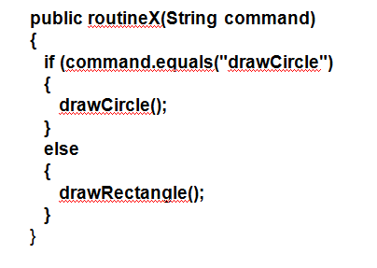
Example of control coupling

Slide 32
Stamp coupling:
The complete data structure is passed from one module to another module
Occurs whenever one of your application classes is declared as the type of a method argument
In this case, this other class is tightly coupled to the first class, any change in the first class will affect the other class' function implementation
Two ways to reduce stamp coupling,
using an interface as the argument type
passing simple variables

Slide 33
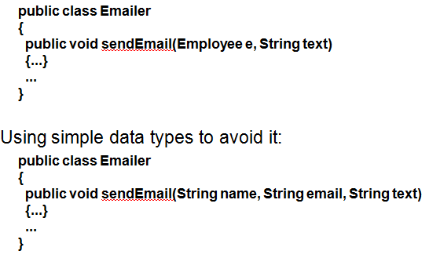
Example of stamp coupling

Slide 34
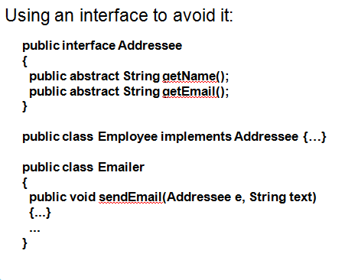
Example of stamp coupling…

Slide 35
Data coupling
Two modules exhibit data coupling if one calls the other directly and they communicate using “parameters'' .
Data passed using parameters.
This coupling occurs when a function has got too many parameters.
The downside of such coupling is that the callers of the function should pass all the arguments, even the ones that does not matter to them.
The more arguments a method has, the higher the coupling
You should reduce coupling by not giving methods unnecessary arguments
There is a trade-off between data coupling and stamp coupling
Increasing one often decreases the other

Slide 36
Routine call coupling
Occurs when one routine (or method in an object oriented system) calls another
The routines are coupled because they depend on each other’s behaviour
Routine call coupling is always present in any system.
If you repetitively use a sequence of two or more methods to compute something
then you can reduce routine call coupling by writing a single routine that encapsulates the sequence.

Slide 37
Inclusion or import coupling
Occurs when one component imports a package
(as in Java)
or when one component includes another
(as in C++).
The including or importing component is now exposed to everything in the included or imported component.
If the included/imported component changes something or adds something.
This may raises a conflict with something in the includer, forcing the includer to change.
An item in an imported component might have the same name as something you have already defined.

Slide 38
External coupling
When a module has a dependency on such things as the operating system, shared libraries or the hardware
It is best to reduce the number of places in the code where such dependencies exist.
The Façade design pattern can reduce external coupling

Slide 39
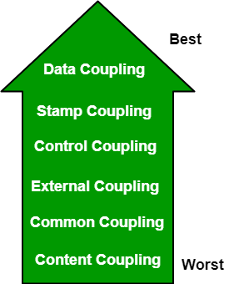
Levels of Coupling

Slide 40
Design Principle 4: Keep the level of abstraction as high as possible
An abstraction is a tool that enables a designer to consider a component at an abstract level without bothering about the internal details of the implementation.
Ensure that your designs allow you to hide or defer consideration of details, thus reducing complexity
A good abstraction is said to provide information hiding
Abstractions allow you to understand the essence of a subsystem without having to know unnecessary details

Slide 41
Abstraction and classes
Classes are data abstractions that contain procedural abstractions
Abstraction is increased by defining all variables as private.
The fewer public methods in a class, the better the abstraction
Superclasses and interfaces increase the level of abstraction
Attributes and associations are also data abstractions.
Methods are procedural abstractions
Better abstractions are achieved by giving methods fewer parameters

Slide 42
Design Principle 5: Increase reusability where possible
Design the various aspects of your system so that they can be used again in other contexts
strategies for increasing reusability are as follows:
Generalize your design as much as possible
Follow the preceding three design principles
Design your system to contain hooks
Simplify your design as much as possible

Slide 43
Design Principle 6: Reuse existing designs and code where possible
Design with reuse is complementary to design for reusability
Actively reusing designs or code allows you to take advantage of the investment you or others have made in reusable components
Cloning should not be seen as a form of reuse

Slide 44
Design Principle 7: Design for flexibility
Also known as adaptability
Actively anticipate changes that a design may have to undergo in the future, and prepare for them.
Reduce coupling and increase cohesion
Create abstractions
Do not hard-code anything
Leave all options open
Do not restrict the options of people who have to modify the system later
Use reusable code and make code reusable

Slide 45
Design Principle 8: Anticipate obsolescence
Plan for changes in the technology or environment so the software will continue to run or can be easily changed
The following are some rules that designers can use to better anticipate obsolescence:
Avoid using early releases of technology
Avoid using software libraries that are specific to particular environments
Avoid using undocumented features or little-used features of software libraries
Avoid using software or special hardware from companies that are less likely to provide long-term support
Use standard languages and technologies that are supported by multiple vendors

Slide 46
Design Principle 9: Design for Portability
Have the software run on as many platforms as possible
Avoid the use of facilities that are specific to one particular environment
E.g. a library only available in Microsoft Windows

Slide 47
Design Principle 10: Design for Testability
Take steps to make testing easier
Design a program to automatically test the software
Ensure that all the functionality of the code can by driven by an external program, bypassing a graphical user interface
In Java, you can create a main() method in each class in order to exercise the other methods

Slide 48
Design Principle 11: Design defensively
Never trust how others will try to use a component you are designing
Handle all cases where other code might attempt to use your component inappropriately
Check that all of the inputs to your component are valid: the preconditions
Unfortunately, over-zealous defensive design can result in unnecessarily repetitive checking

Slide 49
Design by contract
A technique that allows you to design defensively in an efficient and systematic way
Key idea
each method has an explicit contract with its callers
The contract has a set of assertions that state:
What preconditions the called method requires to be true when it starts executing
What postconditions the called method agrees to ensure are true when it finishes executing
What invariants the called method agrees will not change as it executes

